Slide 1
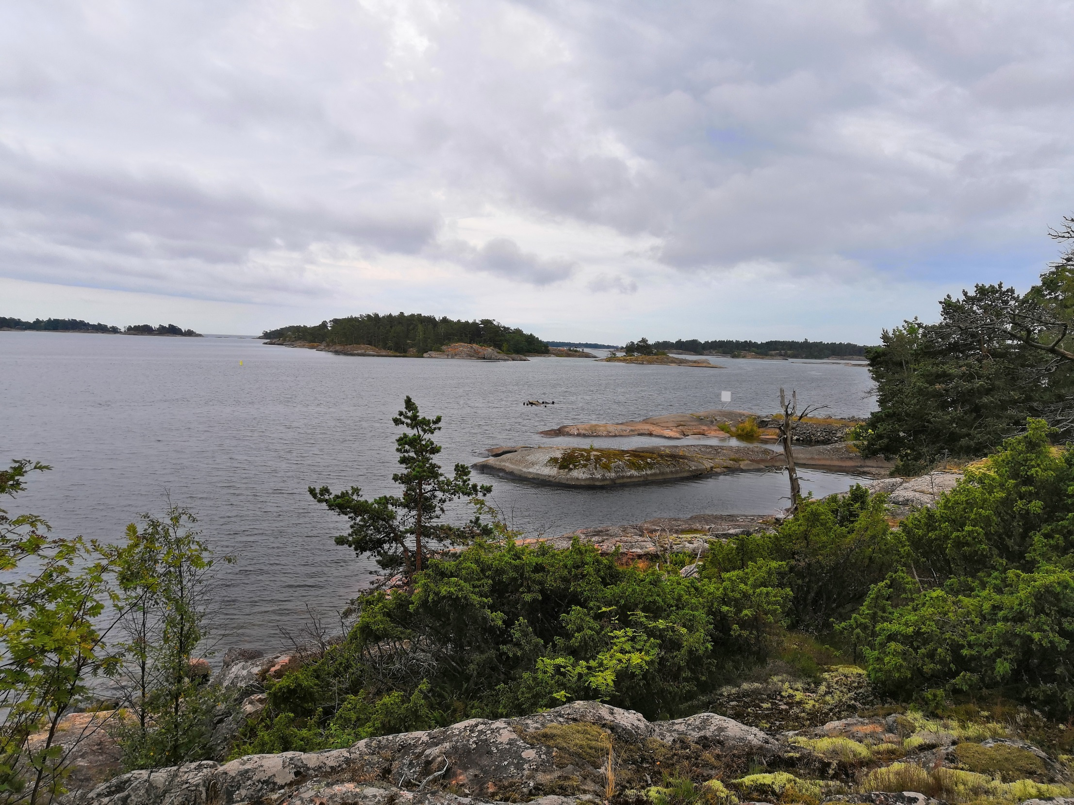
Gulf of Finland Science Days,
“Facing Our Common Future”
Photos
Helsinki 13-14, November 2019
Notes:
Your Excellences, the GOF was a very intensive year…

Slide 2
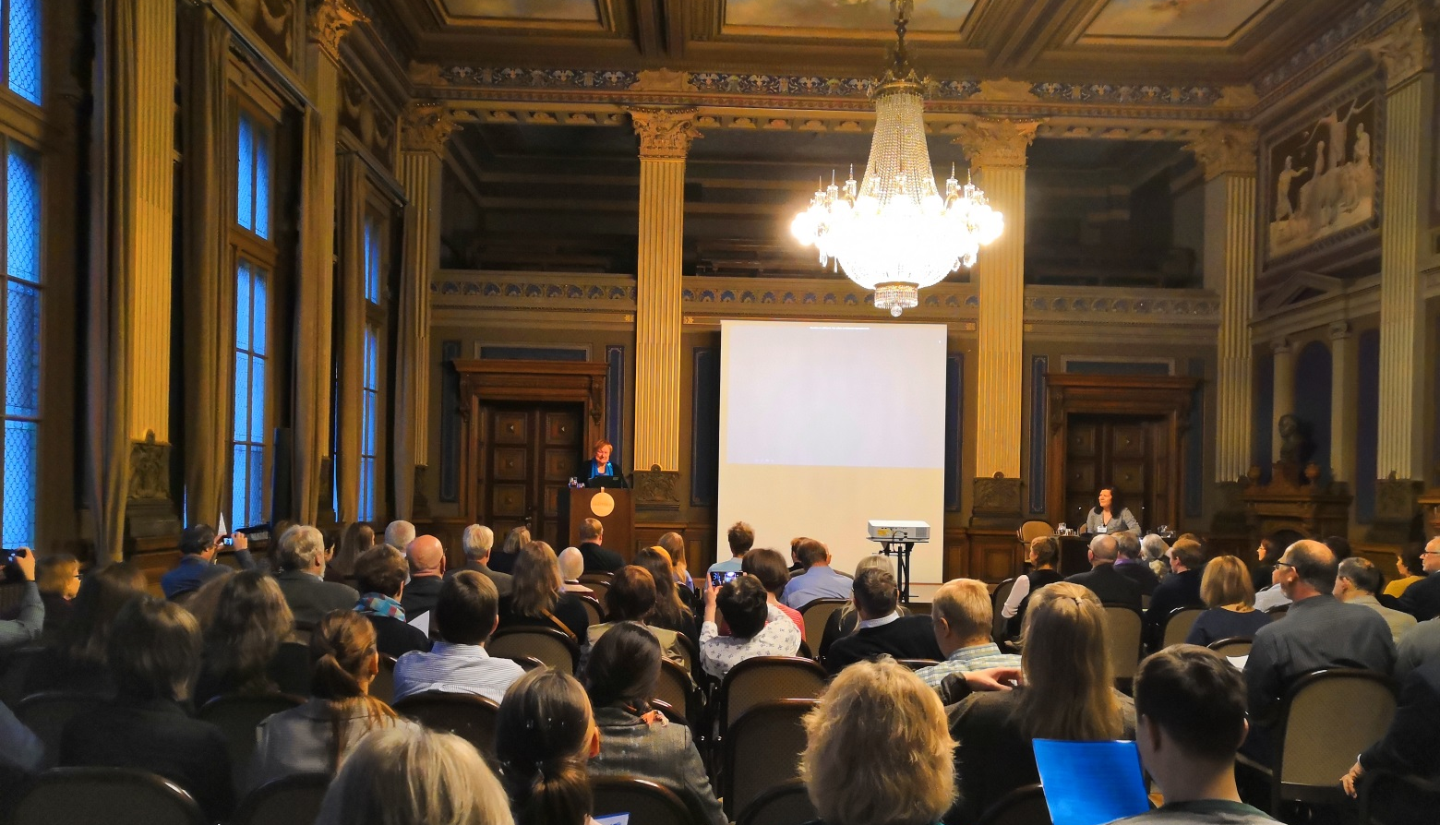
Forum opening by president Tarja Halonen

Slide 3
Permanent Secretary Hannele Pokka of the Ministry of the Environment giving her speech

Slide 4
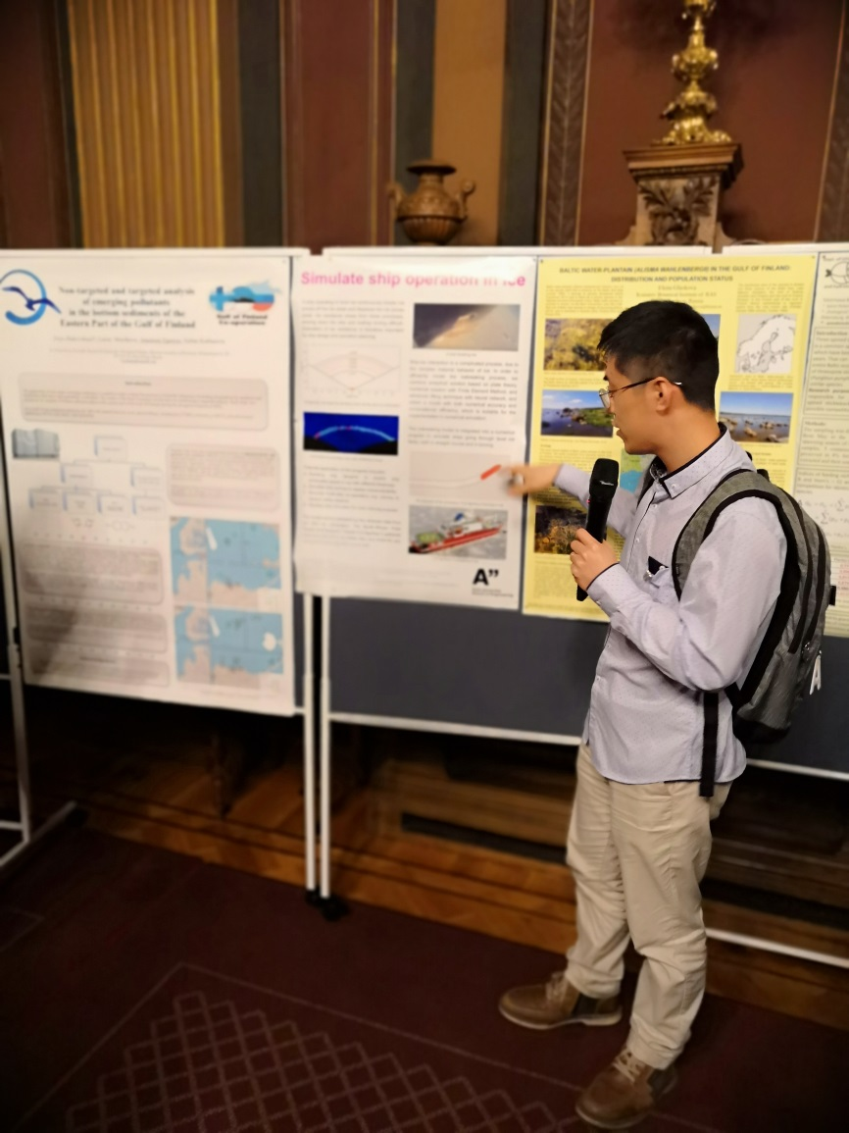
Young scientists session and poster session

Slide 5
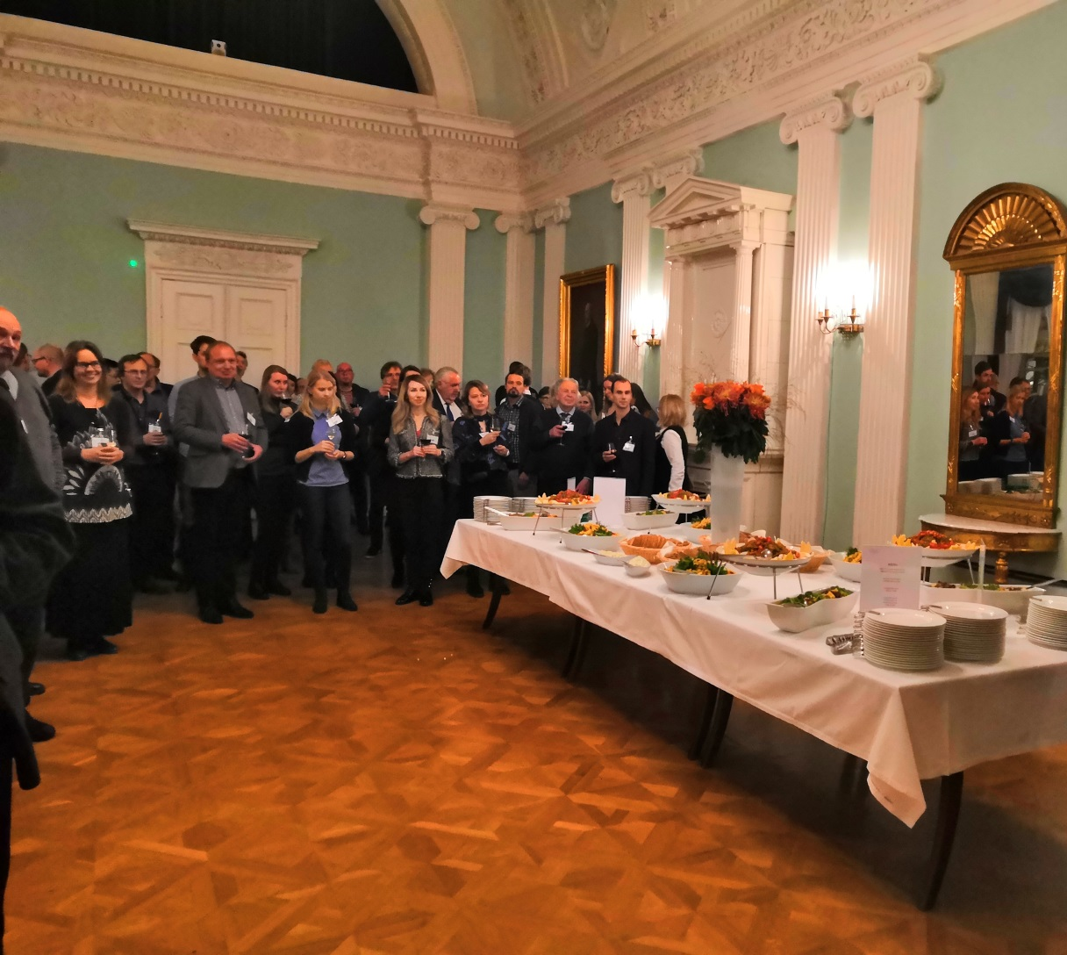
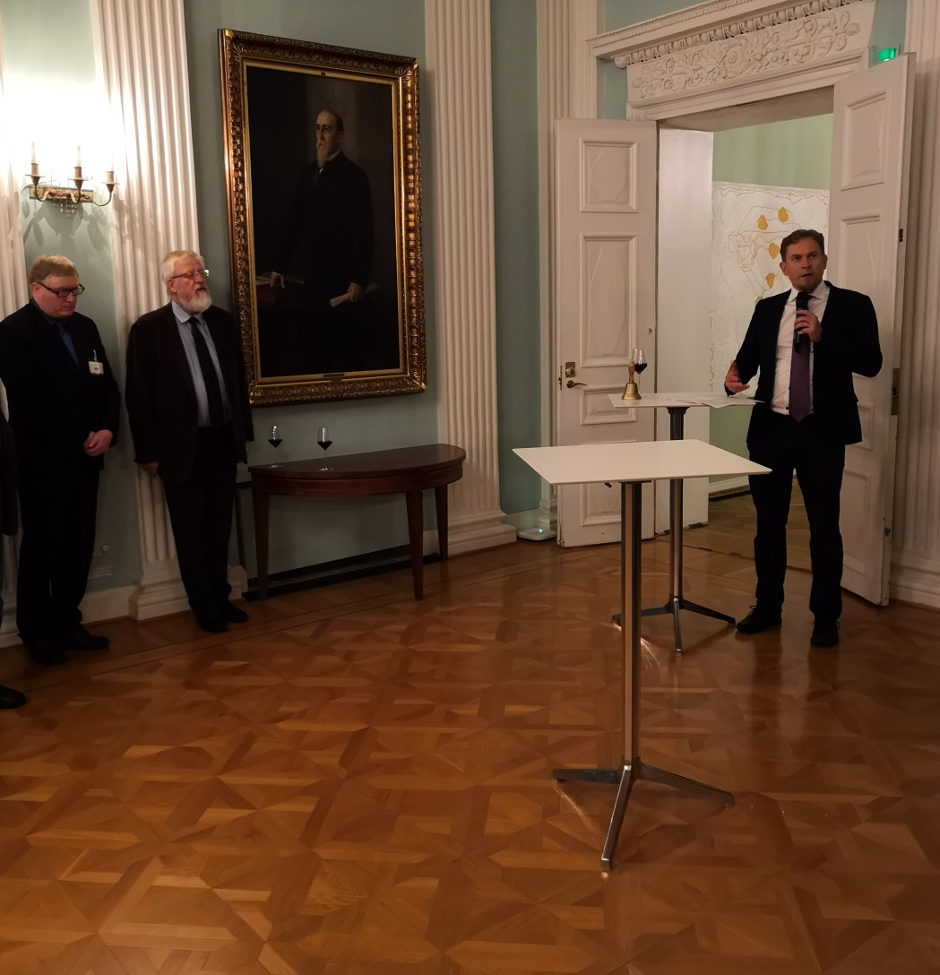
Reception hosted by the City of Helsinki, Old Court House

Slide 6
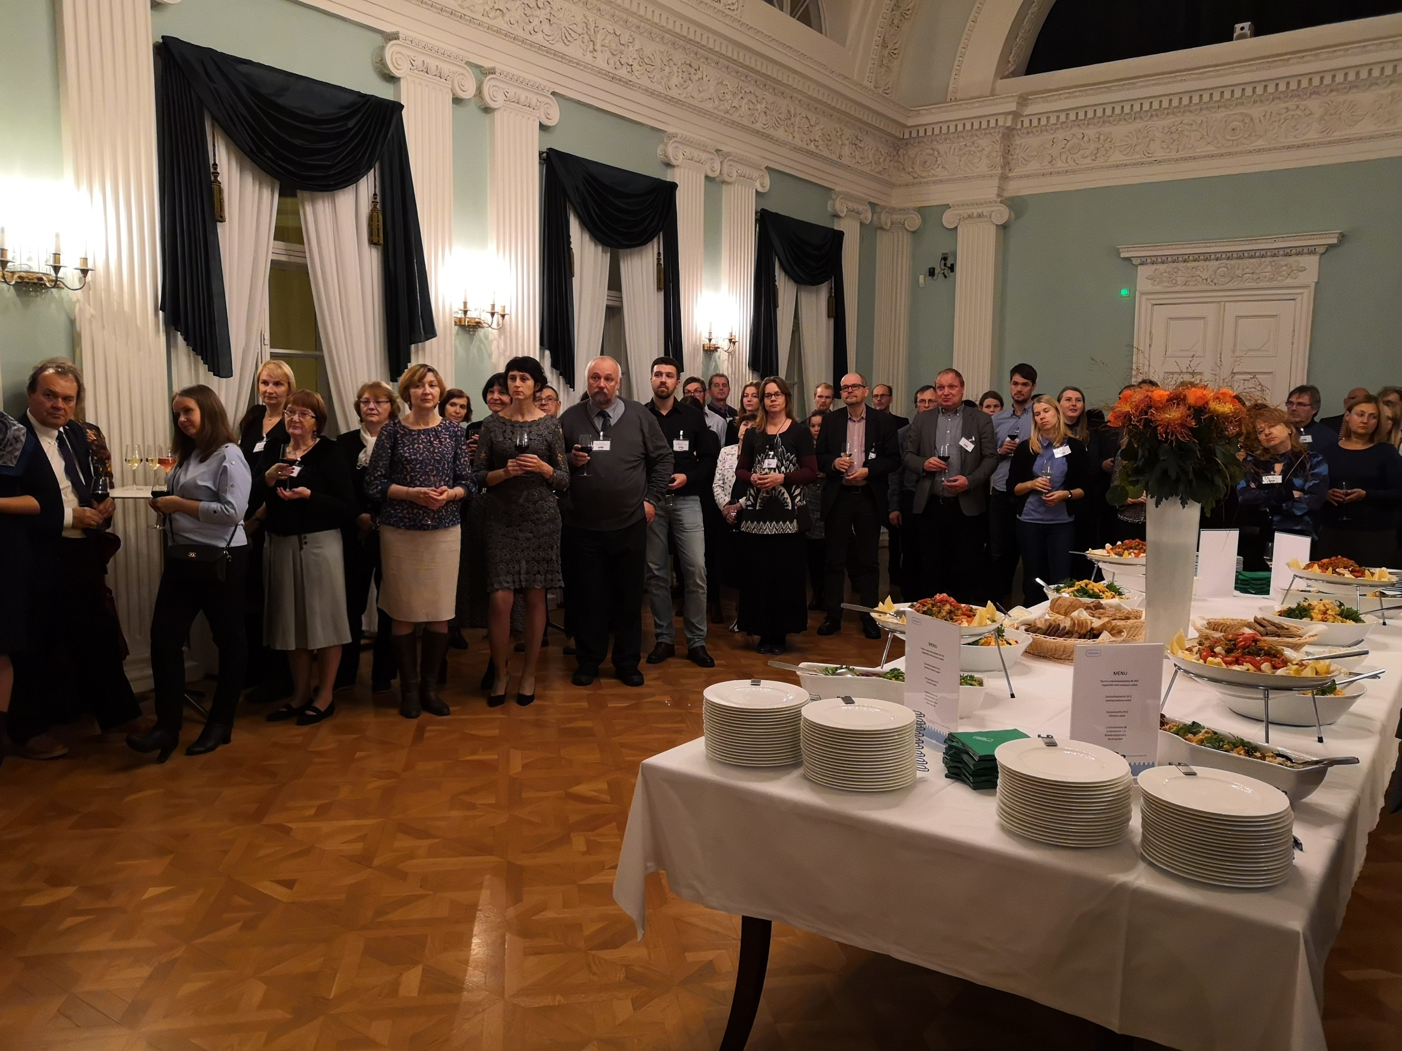

Slide 7
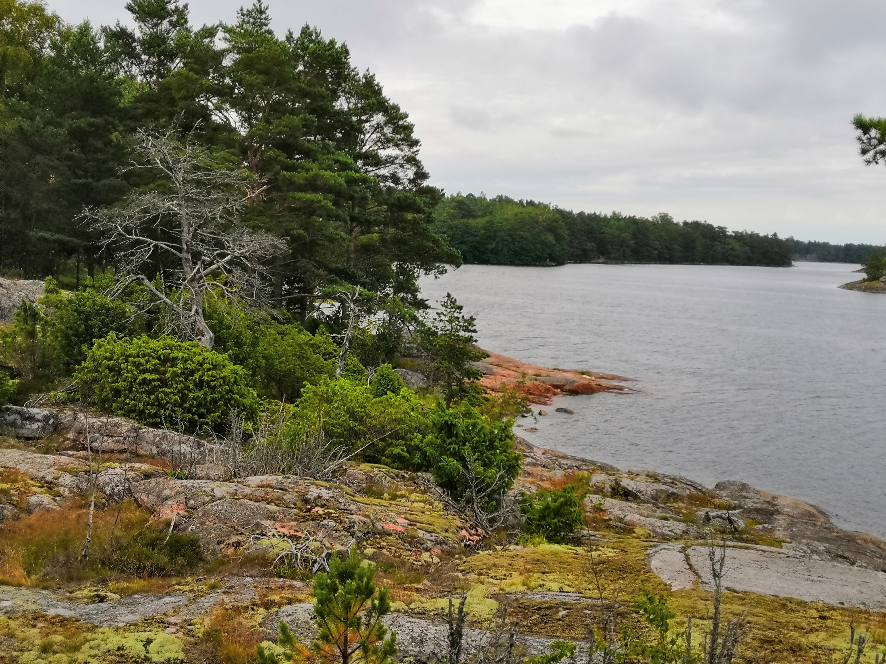
aitäh
KIITOS!
СПАСИБО!
AITÄH!
THAK YOU!

